Slide 1
Blind estimation of acoustic transfer functions (ATFs) and dereverberation based on convolutive transfer functions (CTFs) Date：2024. 05. 01
Telecom Electroacoustics Audio(TEA) Lab
Presenter:
Anchi Yuan
Notes:
Hello everyone
I’m today’s presenter siang. I’m going to share some of my present work in source separation problem. My topic is comparative studies of source separation using semi-blind and blind source separation approaches.

Slide 2
Outline
Simulation setting 1
Simulatio result 1
Simulation setting 2
Simulatio result 2

Slide 3
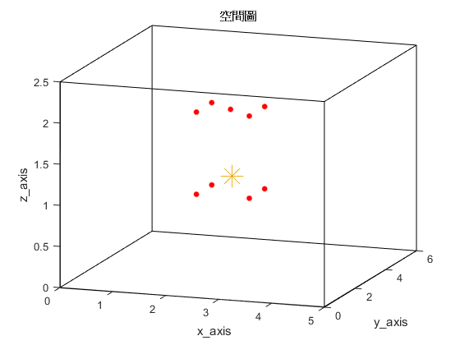

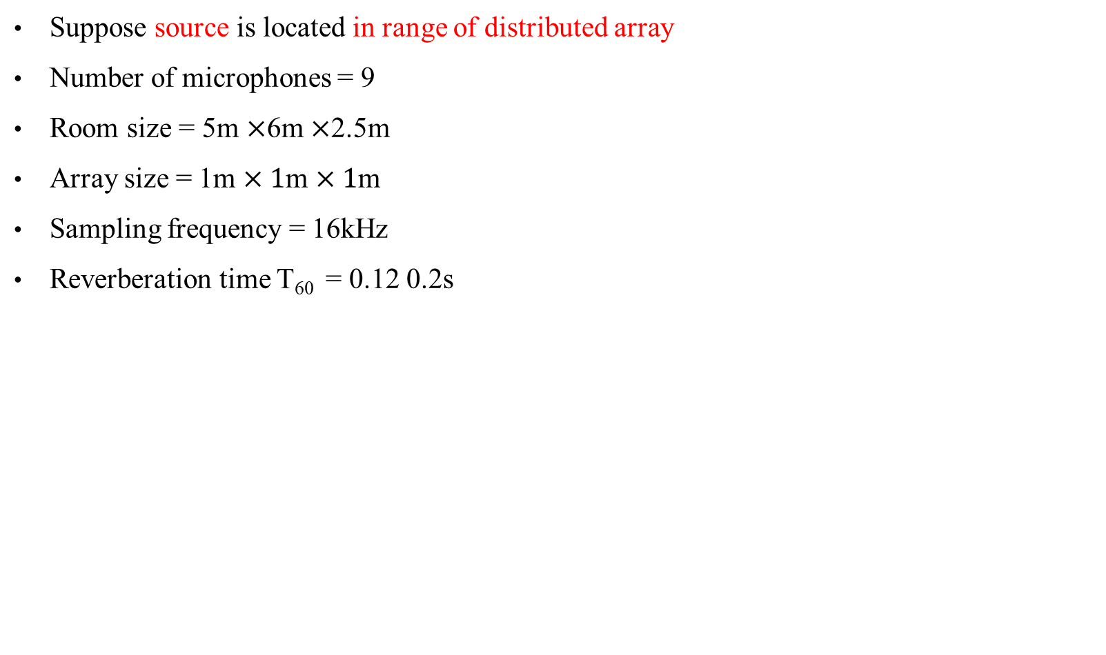
Simulation setting 1
Suppose source is located in range of distributed array
Number of microphones = 9
Room size = 5m $×$6m $×$2.5m
Array size = 1m $×1$m $×1$m
Sampling frequency = 16kHz
Reverberation time T₆₀ = 0.12 0.2s
Source
Mics
Reference mic

Slide 4
Simulation result 1
source position with respect to reference mic | X-axis (m) | Y-axis (m) | Z-axis (m)
Ground-truth | 0.3 | 0.7 | 0.2
T₆₀ = 0.12s | 0.3031 | 0.6990 | 0.1929
T₆₀ = 0.2s | 0.2974 | 0.7052 | 0.1956

Slide 5
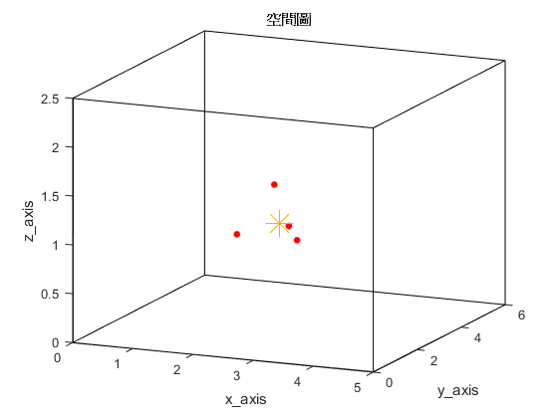

Simulation setting 2
Suppose source is located in range of distributed array
Number of microphones = 4
Room size = 5m $×$6m $×$2.5m
Sampling frequency = 16kHz
Reverberation time T₆₀ = 0.12 0.2s
Source
Mics
Reference mic

Slide 6
Simulation result 2
source position with respect to reference mic | X-axis (m) | Y-axis (m) | Z-axis (m)
Ground-truth | 0.56 | 0.3933 | 0.1
T₆₀ = 0.12s | 0.4996 | 0.3756 | -0.1952
T₆₀ = 0.2s | 0.4996 | 0.3756 | -0.1952

Slide 7



